Slide 1
Management System for a Multiplex

Slide 2
INTERDICTION
The proposed project will be used in maintaining the data of all the movie & ticket for the multiplex . It keeps the track of the movie so that the customer can get the details of the movie in respect of ticket booking ,booking time of the movie & the upcoming movies. On the availability of the seats, ticket can be booked in advanced and the customer may also cancel the ticket before the movie starts . As there are the three screens the customer have multiple choice of watching the movies. It also keeps the track of seats book in advance & current status . They can also get details of the ticket price..

Slide 3
NEED OF SYSTEM
Goal of analyst here is recognition of basic problems elements as perceived byte multiplex and understand software into the system context. In order to identify the need there is need to establish multiplex customer and software development organization. We should recognize the following need of the customer coming in multiplex- Present Movie Seats Available Timing of the Movie Price of the Movie

Slide 4
OBJECTIVES OF SYSTEM
Through this project we present a comprehensive solution for ticket booking in multiplexes. Theater management system, an online ticket selling software that is easy to understand, easy to use and offers the simplicity of fast point-and-click service to the customers.
This powerful software program is specifically designed for theater owners, to sell tickets online. Theater management controls all back-end functionalities like, movie details, ticket rate and showtime, customer information and sales history saved in a database, etc. Theater admin manages the report details like counter wise report, daily, monthly report and movie report etc.

Slide 5
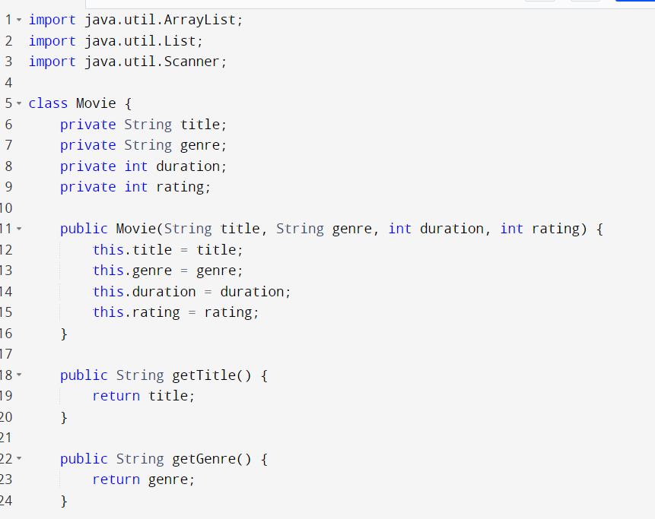
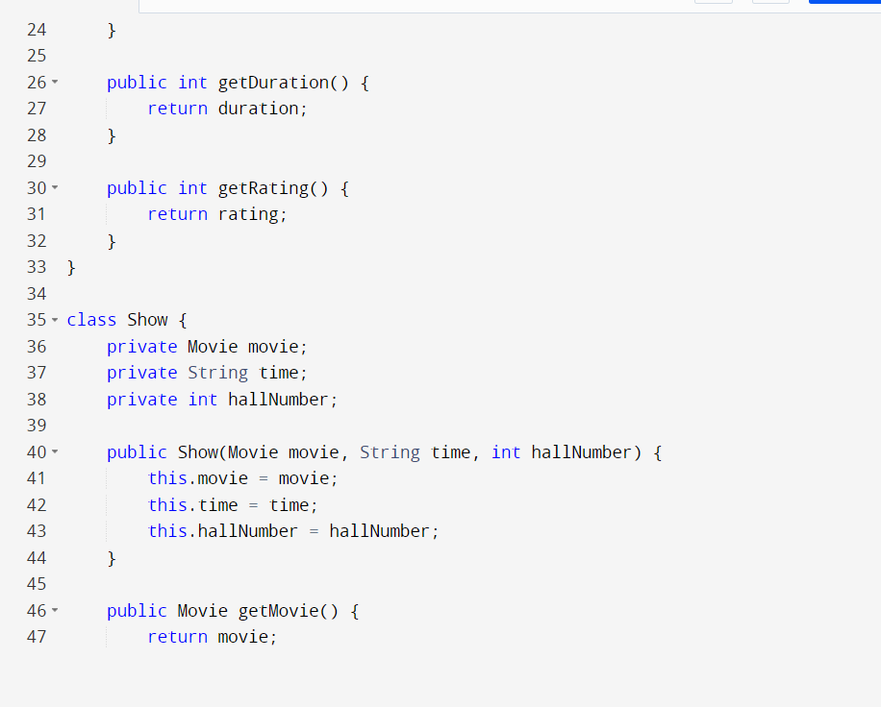

Slide 6
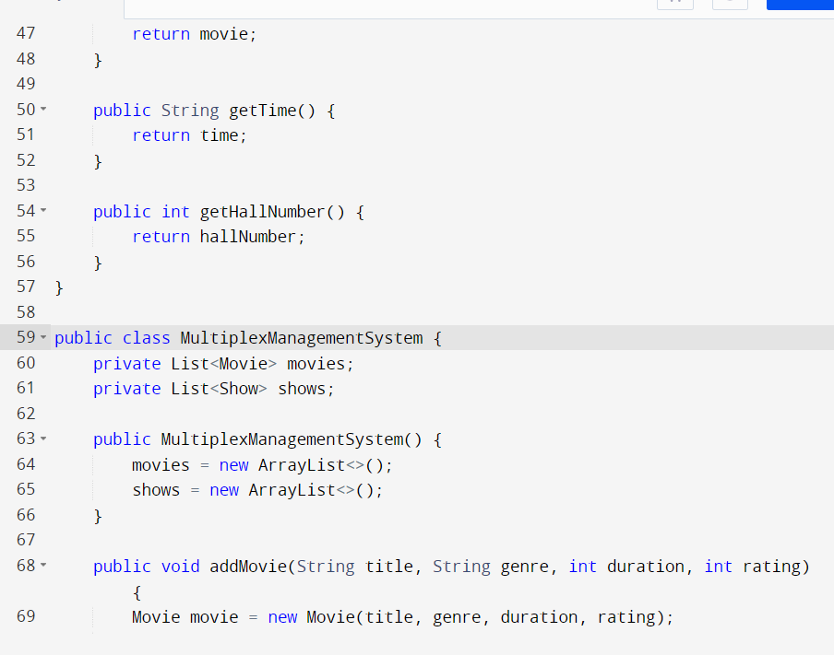
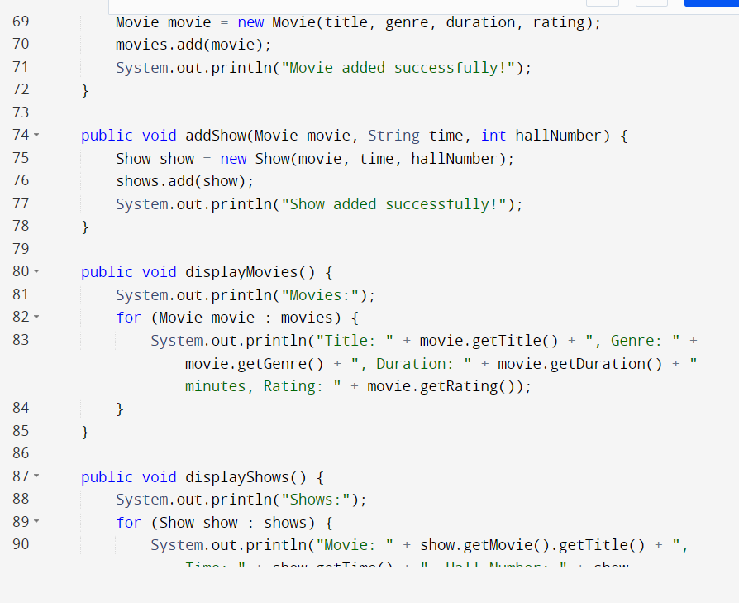

Slide 7
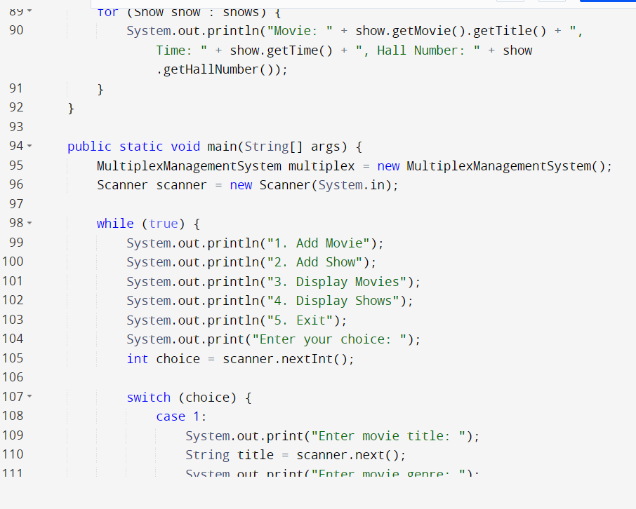
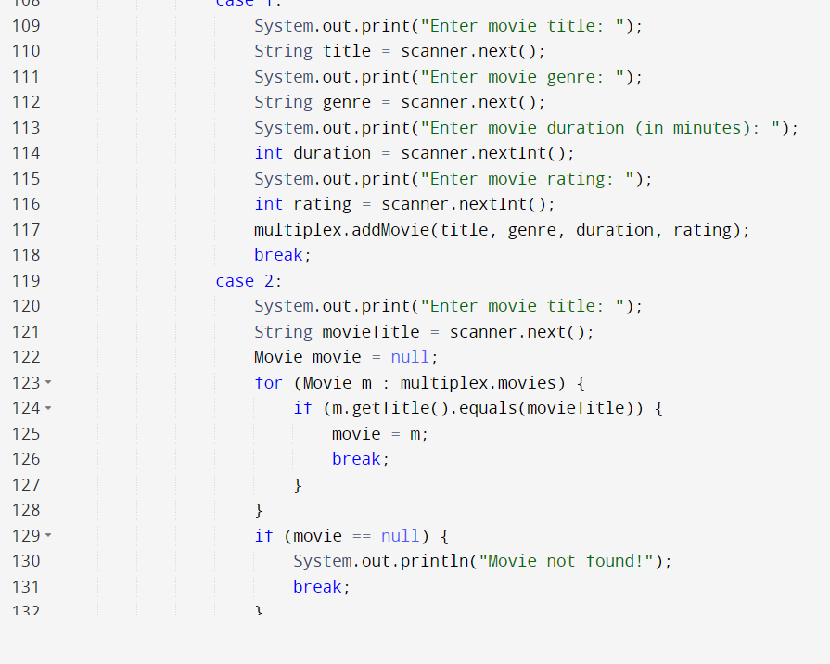

Slide 8
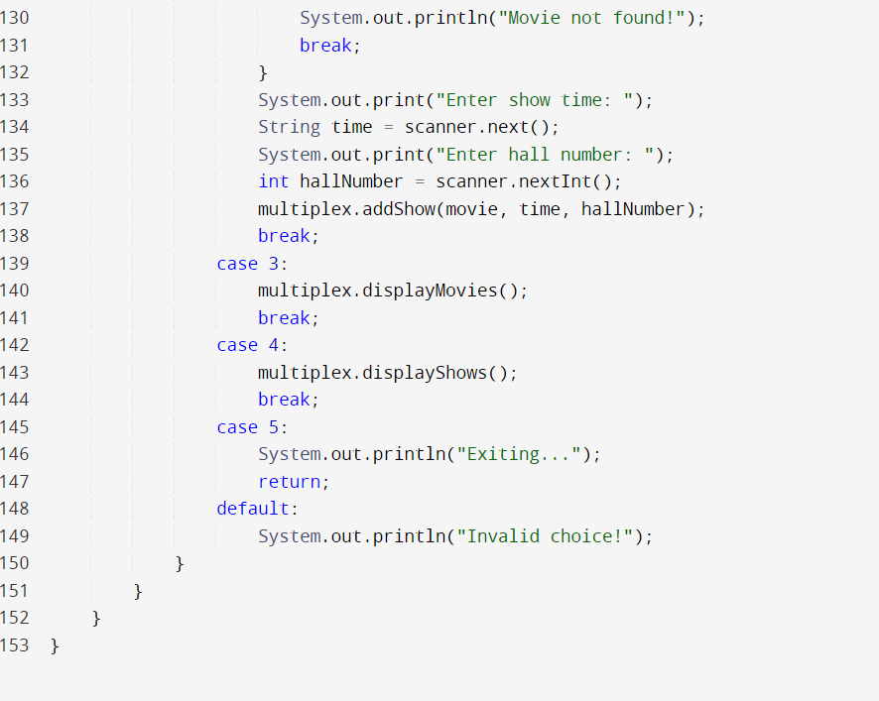

Slide 9
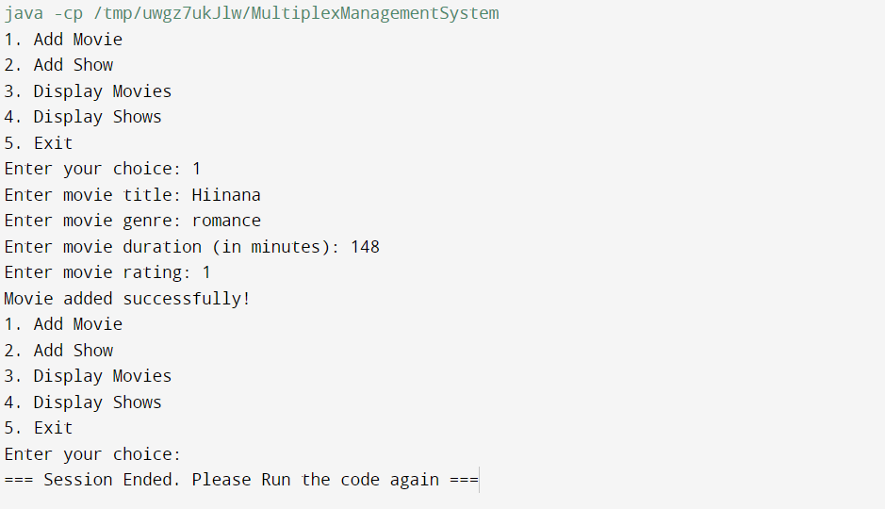

Slide 10
ADVANTAGES
Easy to operate
Password security
Rights reserve to administrator
Seats selection facility
Seats cancellation before ticket printing
Record updating
Modification
Total calculation of collection monthly and daily

Slide 11
CONCLUSION
The project entitled "MULTIPLEX MANAGEMENT SYSTEM "which keep the day by day tally record as a complete multiplex systemic keep the information of movies, tickets sold, tally accounts and also managed it .The exciting part of this project is :-
It displays the day book.
Whole month report
Daily summary

Slide 12


